Slide 1


Biorefining Reinvented:
Sustainable Bioproducts Produced in 20 Seconds

Slide 2
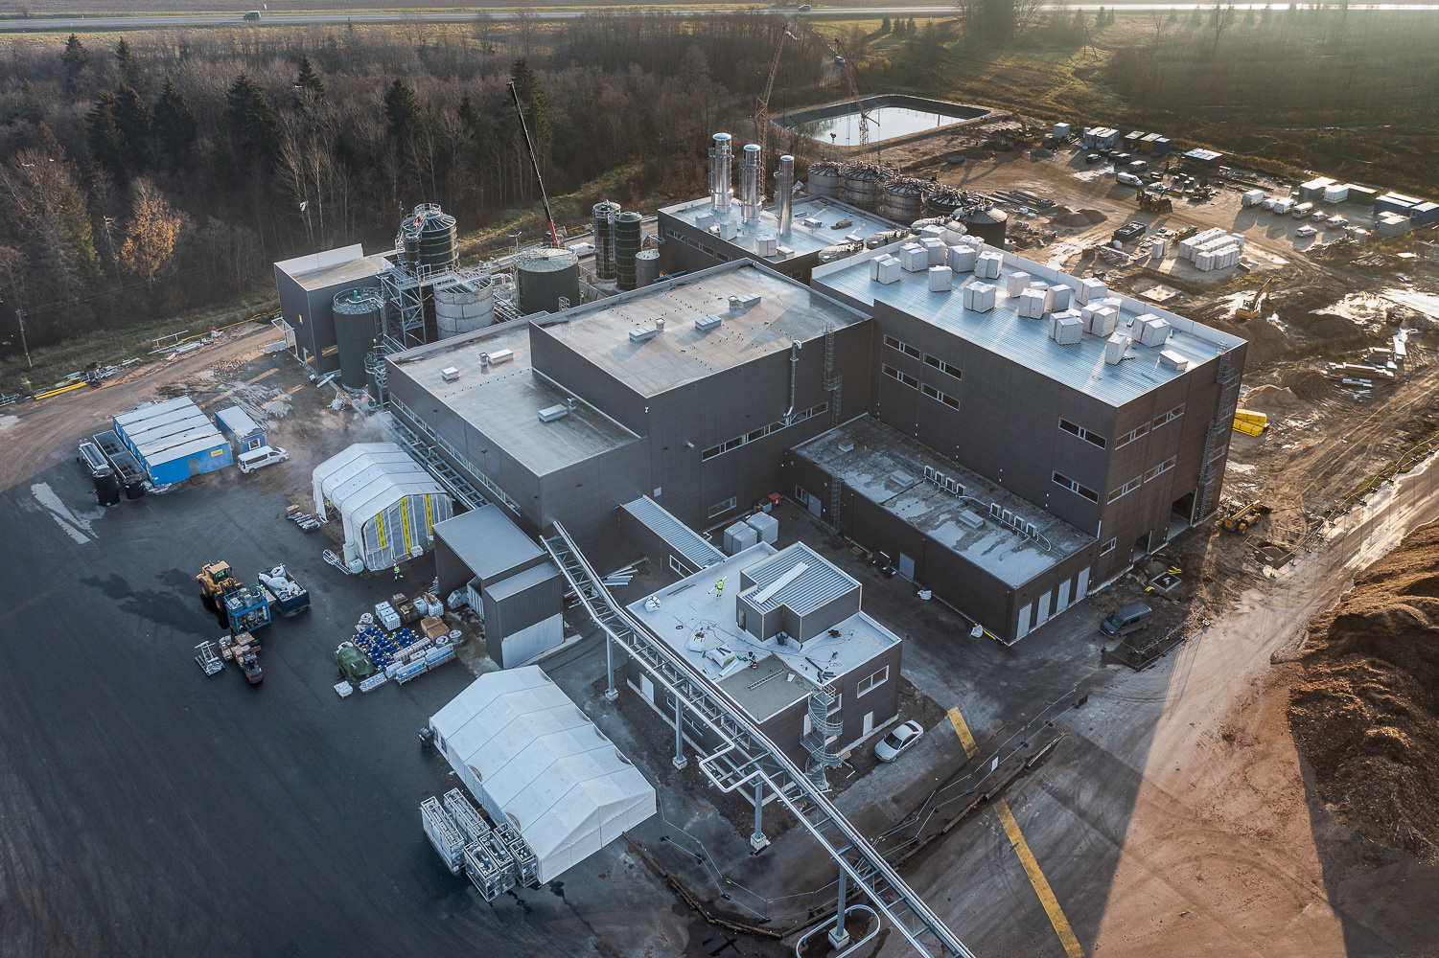
Sunburst Technology and Commercialization
TM
Sweetwater’s modular biorefining technology, SunburstTM, is feedstock flexible, and has now been proven at commercial scale (>80 dry MT feedstock processed/day per module), first on woody biomass
Efficiency Breakthrough: > 90% of biomass converted to economically competitive, sustainable building blocks: sugars, cellulose and non-sulfonated lignin for biofuels, biochemicals, and advanced materials.
76 worldwide patent filings; over 2000 claims
Recent Sustainable Aviation Fuel (SAF) agreement with Gevo will require multiple modular Sunburst systems at plant locations, initially in Minnesota
Sweetwater is working with multiple global partners for additional product applications using cellulosic sugars, specialty cellulose and lignin biopolymers

Slide 3
Sunburst Pretreatment Technology
TM
Reliable, Scalable, Efficient and Feedstock Flexible
Sustainable Woody Biomass Feedstock
Gentle & Fast: No Inhibitors
Pretreated Material: “Chocolate Mousse”
Mean particle size:
~30 µm

Slide 4

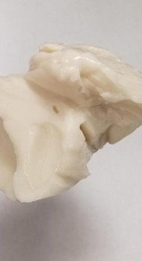
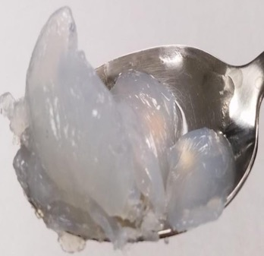
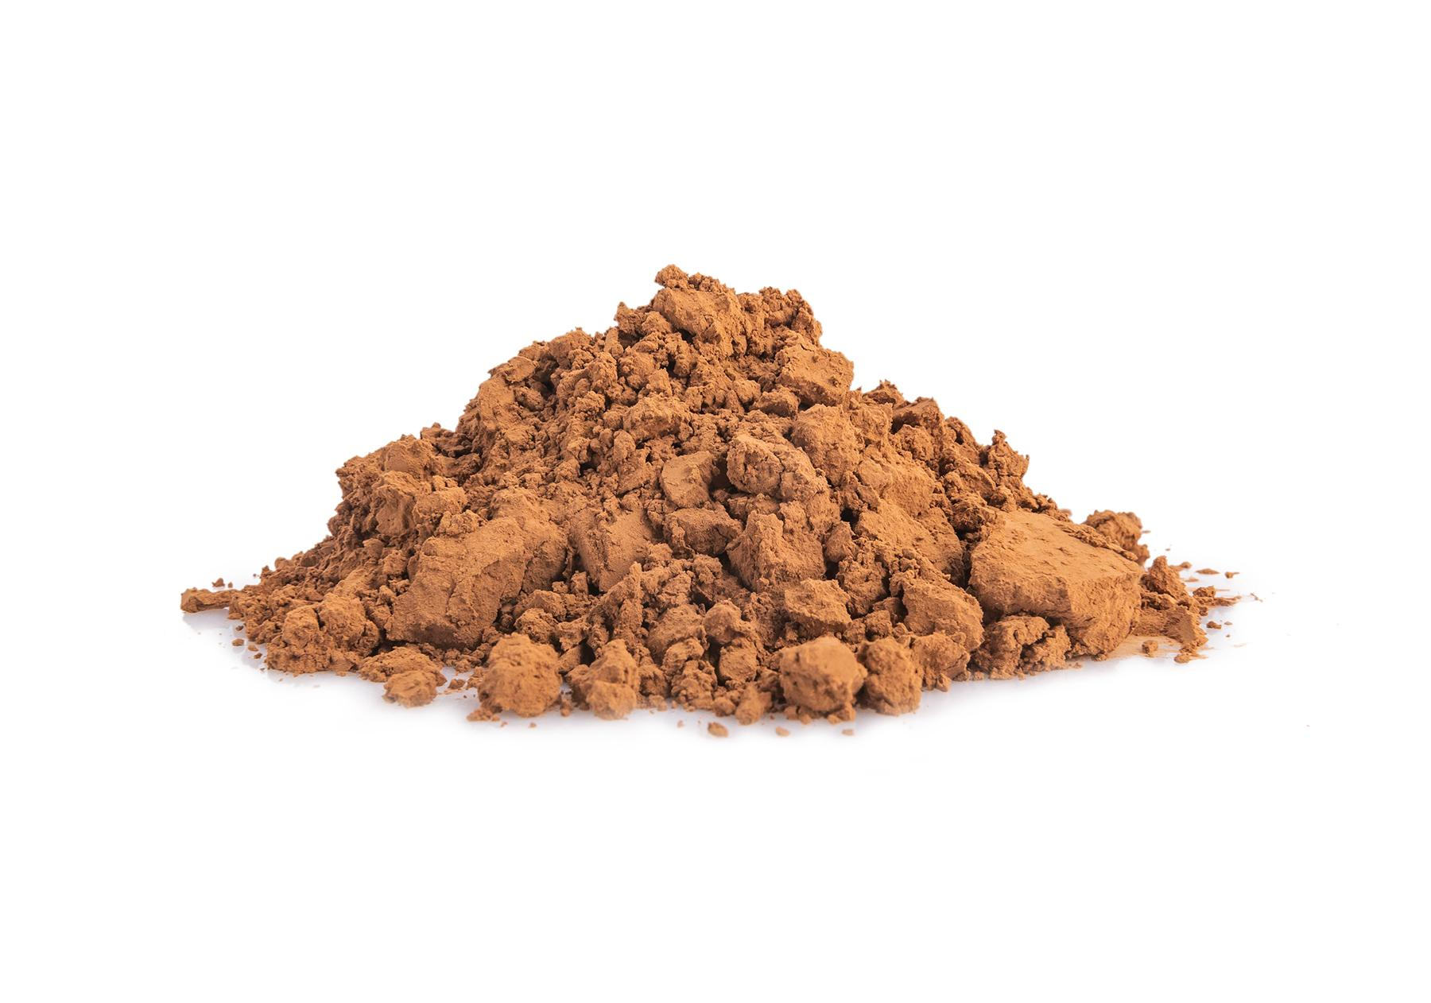
Sweetwater Initial Product Off-Take Priorities
Sweetwater’s SunburstTM technology efficiently creates three sustainable groups of co-products that will allow us to compete directly with petroleum and paper industry-derived products on a price basis, without subsidy.
Cellulosic Sugars for sustainable aviation fuel, industrial alcohol, fuel ethanol, biochemicals, xylitol and dextrose
Specialty Cellulose for barrier coatings in packaging to replace PFAS, reduce weight and cost in paper and packaging products; increase strength in cement & building materials
Lignin Biopolymer for adhesives, epoxies, polyurethanes, polyols, rigid and soft foam products, and marine fuel

